Slide 1

Maketing et Publicité

Slide 2
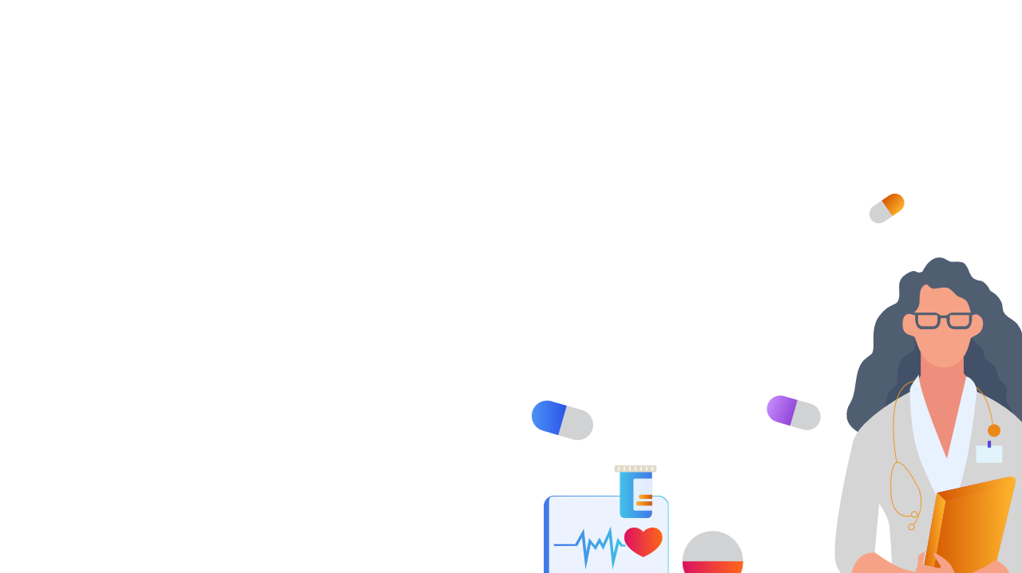
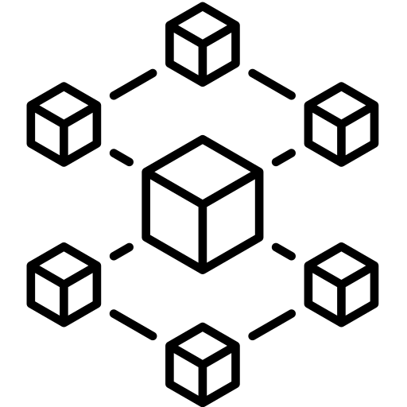
Blockchain technology has been gaining a lot of attention in recent years as an innovative solution for healthcare. It has the potential to revolutionize the healthcare industry, by providing a secure and transparent way to store and share patient data. This essay will explore the various uses of blockchain technology in healthcare, and how it can be used to improve patient outcomes and increase efficiency in the healthcare system.
We will look at how blockchain can be used to enhance data security and privacy, streamline the billing and claims process, and improve patient engagement. Finally, we will discuss the challenges and potential risks associated with the adoption of blockchain in healthcare.

Slide 3
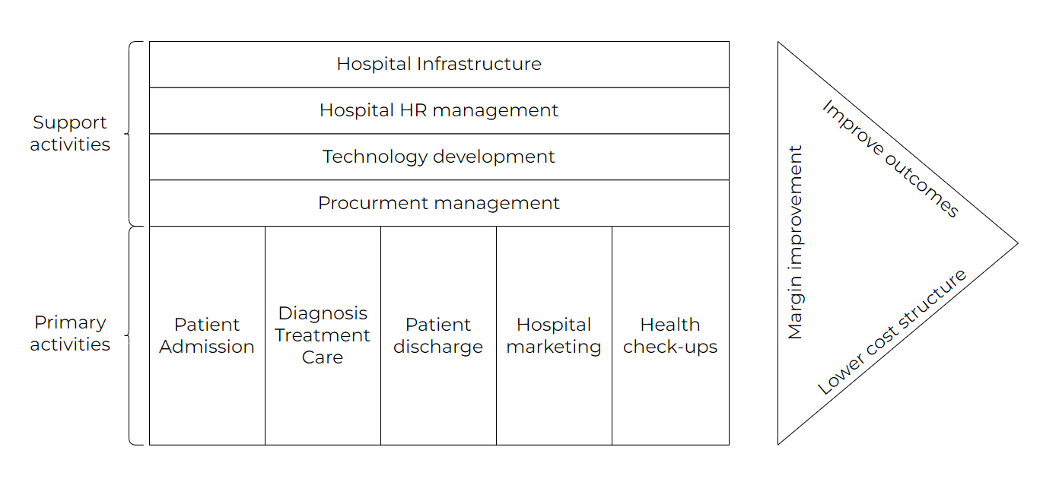
Healthcare value chain
Payers of healthcare services include government entities, insurance companies, and individuals. Providers encompass hospitals, nursing homes, clinics, pharmacies, and home health services. Producers are the companies that manufacture the equipment, medicines, and other products used in hospitals.
The primary activities of hospitals range from the moment a patient is admitted to their eventual discharge, as well as any activities that bring a patient to a hospital, like ambulatory services and marketing.
Support Services include the services like infrastructure management, procuring new staff and retaining them i.e. human resource management, establishing new technologies and IT services, and supply chain management.

Slide 4
now we will define the blockchain stated previously, state its key elements, how it works and some of its overall benefits

Slide 5
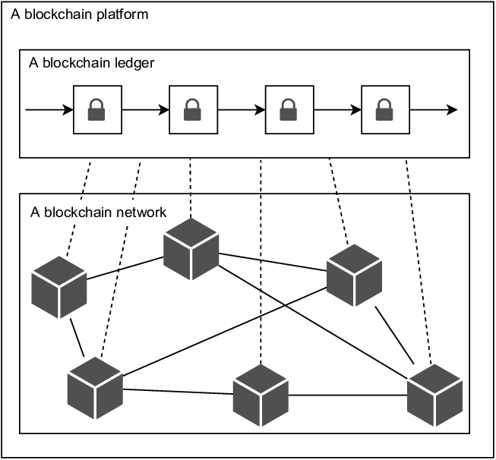
Blockchain is a form of distributed ledger technology, which is a digital record that is maintained and shared by multiple parties. It is a distributed database that is constantly growing and is used to store and track records of digital transactions. The records are stored in a chain of blocks, which are linked together using cryptography. Each block contains data, a hash, (a timestamp and a) and a previous hash linked to the previous block, which makes it virtually impossible to alter or delete the data stored in the blocks. This allows for a secure and immutable record of digital transactions, which can be used to track assets, create smart contracts, and facilitate financial transactions.

Slide 6
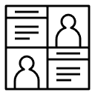
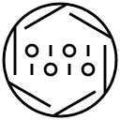
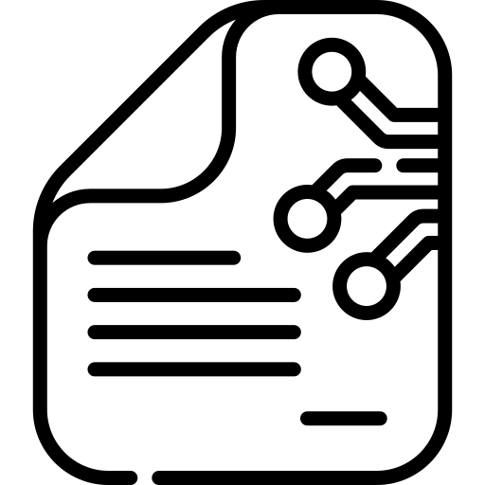
Key elements of a blockchain
Distributed Ledger
A distributed ledger is a database that is shared, replicated, and synchronized among the members of a decentralized network. It records and stores all the transactions that take place in the network.
Immutable records
No participant can change or tamper with a transaction after it’s been recorded to the shared ledger. If a transaction record includes an error, a new transaction must be added to reverse the error, and both transactions are then visible.
Smart Contracts
Smart contracts are self-executing contracts that are stored on the blockchain. They are programs that can be used to automate certain tasks and enforce the performance of a contract.

Slide 7
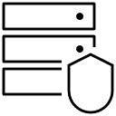
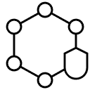
How the blockchain works
Every transaction is documented as a "block" of data. This block can capture whatever data is necessary - who, what, when, where, how much and even the conditions - such as the temperature of a shipment. These blocks are linked together, forming an unchangeable chain of data that follows an asset as it changes ownership. Every new block further strengthens the verification of the previous block, and thus the entire blockchain, making it virtually impossible for any malicious actor to tamper with it. This creates a ledger of trustable transactions between network members.
Blockchains are secured through a combination of cryptographic techniques, such as hashing, digital signatures, and consensus algorithms. Hashing involves taking an input of any length and producing an output of a fixed length. This output is known as a "hash," and it is used to verify the integrity of data that is stored in the blockchain. Digital signatures are used to authenticate users and to ensure that transactions are valid. Consensus algorithms are used to ensure that all participants of the blockchain agree on the same set of data. This consensus is achieved through a system of distributed trust and distributed computing which is based on a P2P (peer to peer) network.

Slide 8

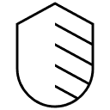
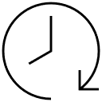
Benefits of the blockchain
Enhanced trustworthiness The blockchain enables trust between network by providing a secure, tamper-proof system of recording and sharing data. Only those with permission can view data, and all changes are validated by consensus.
Heightened security Using blockchain technology, data is securely stored and shared among network members. It is impossible to delete or modify a transaction, ensuring data accuracy and integrity.
Increased efficiency The distributed ledger of blockchain technology streamlines and accelerates transactions by eliminating the need for reconciliation and allowing smart contracts to be stored and executed automatically.

Slide 9
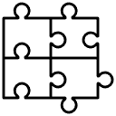
now we will select certain activities and determine their needs, and

Slide 10
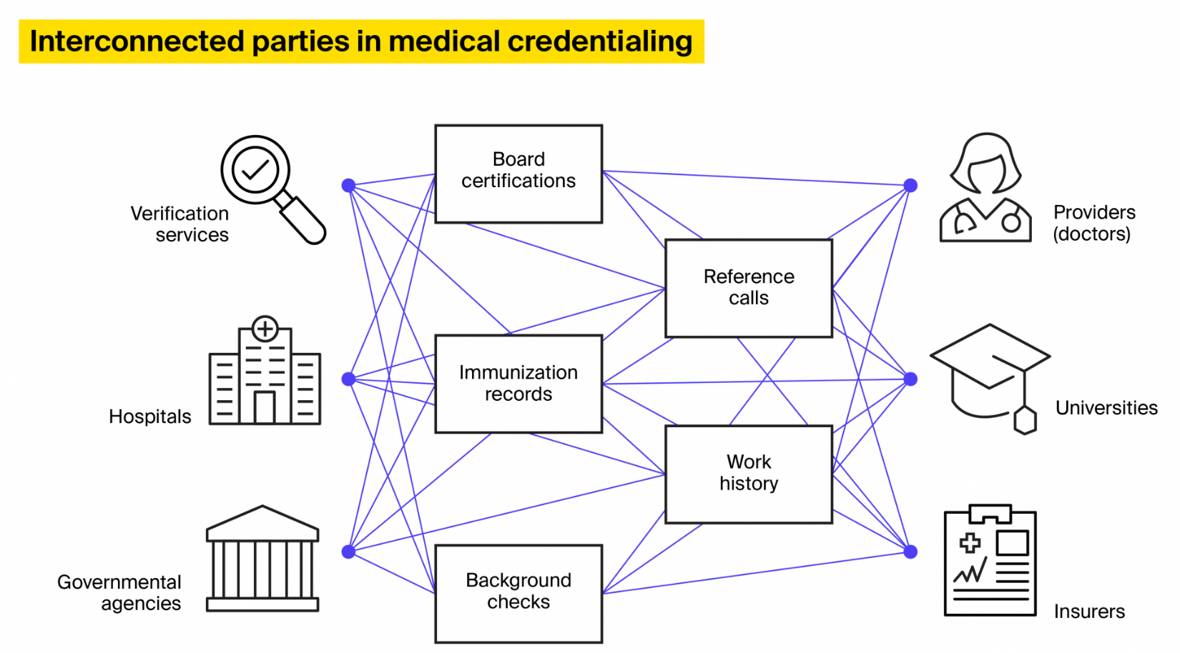

Slide 11


Procurement management
The need in this activity is supply chain transparency

Slide 12
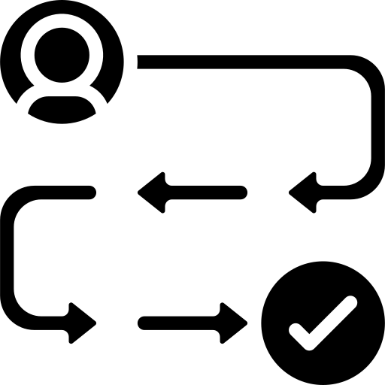
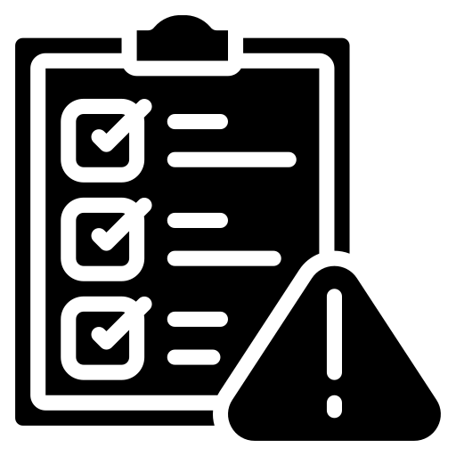
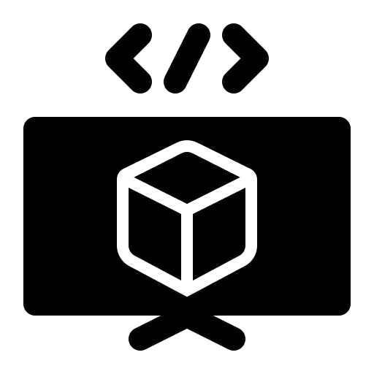
Usage and impacts of the blockchain
The healthcare sector faces a critical challenge to guarantee the legitimacy of medical goods. A blockchain-based system can be used to follow items from the manufacturing stage and through each step of the supply chain, granting customers full insight into their purchases. This is particularly important in areas where fake prescription drugs lead to thousands of fatalities yearly. The problem is also becoming increasingly relevant for medical devices, with the rise of remote health monitoring and subsequent appeal to unscrupulous individuals.
The pairing of blockchain and AI can result in numerous advantages:
for customers, a greater confidence in tracking a package's end-to-end journey
enhanced compliance with reporting burdens
improved supply chain optimization. By aggregating data into one system, companies can leverage AI to accurately predict demand and optimize supply in order to maximize efficiency.

Slide 13

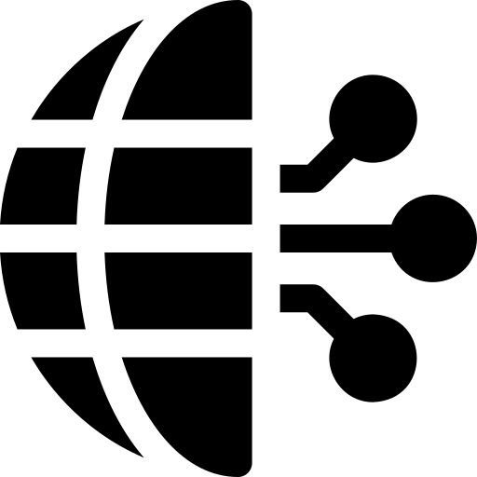
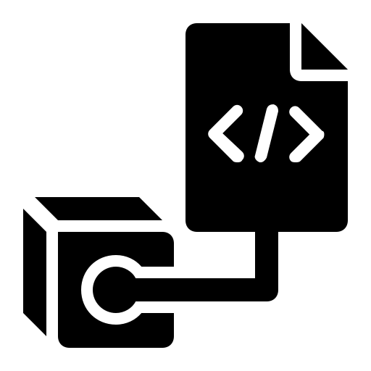
A blockchain-based system could be used to enable organizations in the healthcare sector to identify and authenticate themselves, record contract details, track the transactions of goods and services, and document payment settlement details for these goods and services. This system would go beyond traditional supply chain management to allow trading partners and insurance providers to operate with fully digital and, in certain cases, automated contracts.
By leveraging blockchain technology for the digital contracts between manufacturers, distributers, healthcare organizations, and insurers, disputes over payment chargeback claims for prescription medicines and other goods can be drastically reduced. Moreover, using shared smart contracts to manage medical insurance contracts for patients will enable insurers to access data more easily, enabling them to conduct more advanced analytics to optimize health outcomes and costs.

Slide 14

Health check-ups
The need in this activity is patient-centric electronic records

Slide 15
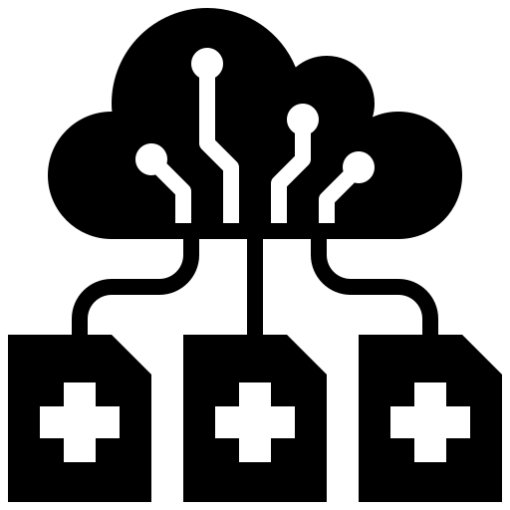
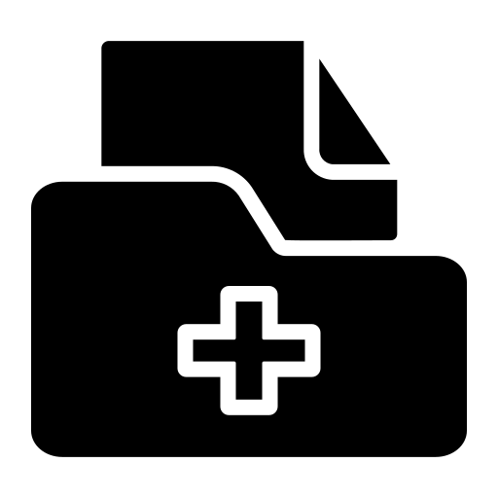
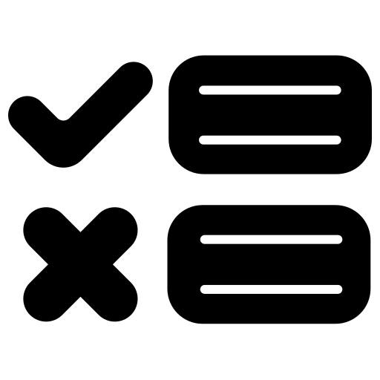

Usage and impacts of the blockchain
Every country and region is struggling with a lack of data coherence in their healthcare systems, resulting in a lack of comprehensive medical histories for patients and their providers.
A potential solution to this problem is to utilize a blockchain-based system for storing medical records which can be integrated with existing electronic medical record software, thus providing a comprehensive view of the patient's record. The actual patient data would not be stored on the blockchain, but each new record - such as a physician's note, prescription, or lab result - would be translated into a unique hash function. This hash function is a sequence of letters and numbers, and can only be decoded with the patient's permission. Whenever a change is made to the patient's record, or when they consent to share part of it, it is logged on the blockchain as a transaction.
The use of blockchain-enabled EMRs provides numerous advantages, such as:
Creating a single, unified source of truth of a patient's medical records, leading to a better experience for both patients and care providers.
A transparent system in which patients can view every update of their medical records and give explicit consent for them to be shared with healthcare providers or researchers.
Letting patients choose to share their medical information (or part of their medical records) with researchers and setting time limits on how long any third party can have access to the data.
Enabling medical insurers to obtain immediate, validated confirmation of healthcare services directly from the patient, eliminating the need for an intermediary and saving time and money.

Slide 16
Hospital HR management
The need in this activity is medical staff credential verification

Slide 17
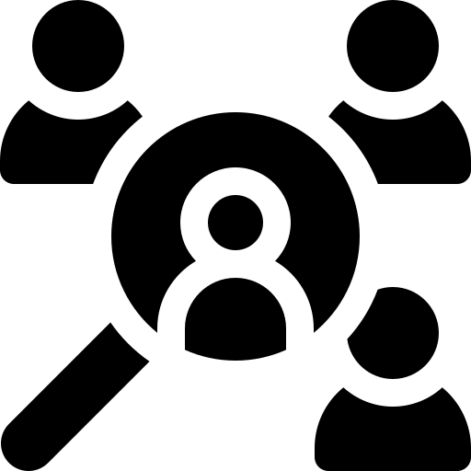

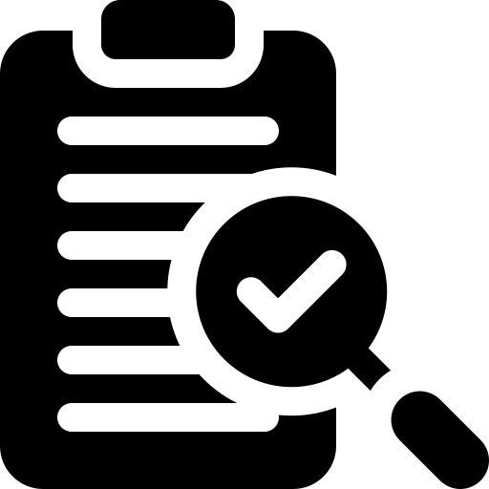
Usage and impacts of the blockchain
By using blockchain technology, the background and qualifications of medical professionals can be tracked, enabling healthcare organizations to access reliable and verifiable information about the experience of their staff. This information can be stored securely, allowing healthcare organizations to quickly and easily identify the most suitable candidates for their roles.
The key benefits of the blockchain system are:
Speeding up the credentialing process for healthcare organizations during the recruitment
Allowing medical institutions, insurers, and healthcare providers to capitalize on their existing credentialing data for current and prior personnel
Granting transparency and trust to partners, e.g. organizations utilizing locum tenens or in the realm of virtual health delivery, to inform patients of the qualifications and experience of medical staff

Slide 18
Hospital infrastructure/technology development
The need in this activity is IoT security for remote monitoring and healthcare data security

Slide 19

Usage and impacts of the blockchain
The utilization of remote monitoring solutions has become increasingly popular in digital health due to the many advantages these solutions offer. By using sensors to measure patients’ vital signs, healthcare providers are able to gain greater insight into their patients’ health, enabling them to be more proactive and preventative in their approach to care. We’ve highlighted the use of remote monitoring in many of our articles on 5G and edge computing in digital health, as these technologies are helping to make remote monitoring solutions more accessible.
Nevertheless, safety is a major concern with regard to health IoT, both when it comes to confirming that a patient's information is confidential and secure and that it is not changed to fabricate false records. In certain cases, where a connected device is necessary for urgent scenarios, e.g. notifying a senior's caregiver of a collapse or cardiac arrest, it is also indispensable that the related systems are highly resistant to DDoS or alternative forms of attack that hinder service.
How blockchain systems could help secure remote monitoring IoT devices:
Blockchain cryptography ensures that only permitted parties can gain access to personal data, which is stored on the blockchain as a unique hash function (any change in the source data will create a different hash function, and a user must have a specific set of cryptographic keys to decode the hash function into the source data).
Once patient data is recorded on the blockchain ledger (as a hash function) then it is nearly impossible to tamper with since it would require gaining access to all stored copies
The decentralized nature of blockchain means that IoT devices can interact directly with each other, without going through a centralized server (as most IoT connections do today), making it very difficult to launch DDoS and man in the middle attacks.

Slide 20
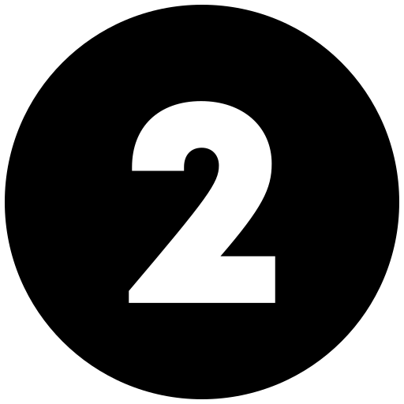
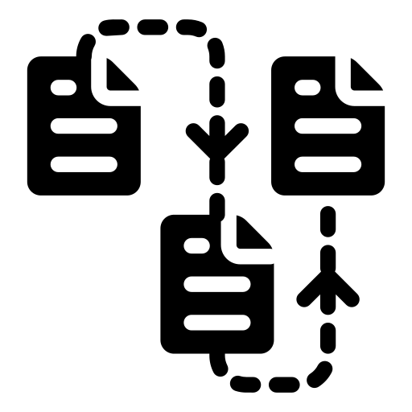
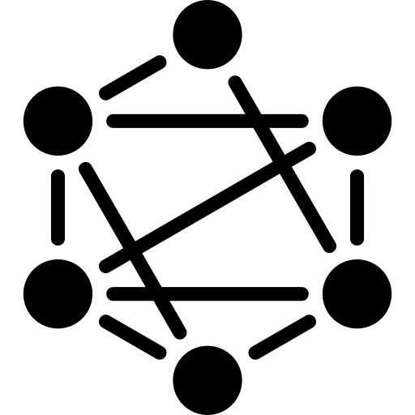
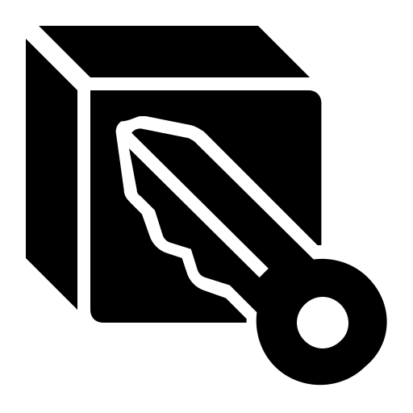
Usage and impacts of the blockchain
Healthcare data security could be significantly impacted by blockchain technology. This technology utilizes immutable ledgers that are updated simultaneously across all participating nodes, making it nearly impossible to tamper with the data. Each “block” of data is connected to all the blocks that come before and after it using unique signatures or “chains,” and if any data needs to be updated, a new block is added, rather than altering the old block. This creates an indelible record, with timestamps, of all data that is added or updated, providing an extra layer of protection for health data.
Blockchains rely upon decentralized consensus, meaning that all members utilizing the blockchain must come to a mutual agreement regarding how data is validated and documented. For a malicious individual to try to exploit this by manipulating the data, they would need to seize control of the majority of the nodes on the network simultaneously and adjust the entire blockchain related to the data that they are targeting. Though not impossible, this is very hard to do due to the high number of nodes in a healthcare-related network.

Slide 21

Done by
Mohamed Amine Fakhre-Eddine

Slide 22




Thank you for reading
You can find me on
@aLonewolf_____
mohamedfakhreeddine2019@gmail.com
Mohamed Amine Fakhre-Eddine

